Slide 1
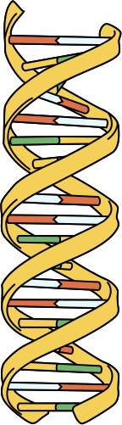

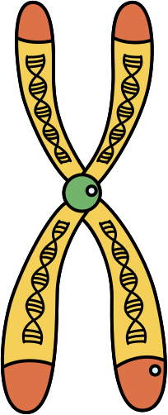
Identifying the Biomarkers for Congenital Heart Disease

Slide 2
Problem Statement
Identification of reliable and accurate biomarkers that can
aid in the diagnosis and management of congenital heart disease

Slide 3

Proposed Solution
Finding and filtering articles
1
2
Handling bias
4
3
Manual Review
Named Entity Recognition

Slide 4
1
Finding and Filtering Articles
Performed by Nirmal, Vinayak Goel, Vinayak Arora and Ishan

Slide 5
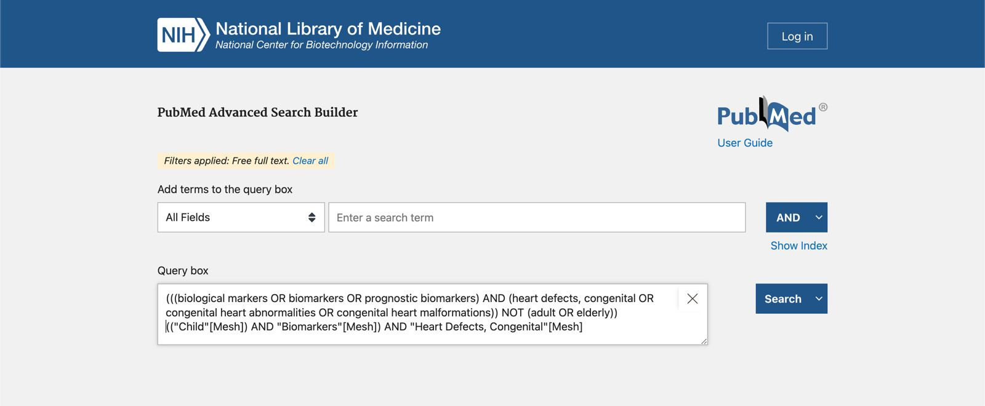
Pubmed Search Query
Created a search query using PubMedAdvanced Search Builder using keywords from our problem statement like Biomarkers, Congenital heart disease, Target Age

Slide 6
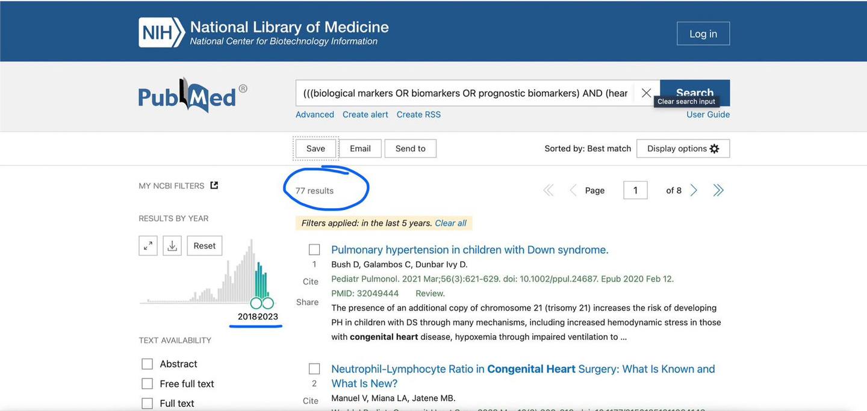
Pubmed Results
The search query fetched 77 results, with filters like papers from past 5 years and target age of under 23 months

Slide 7
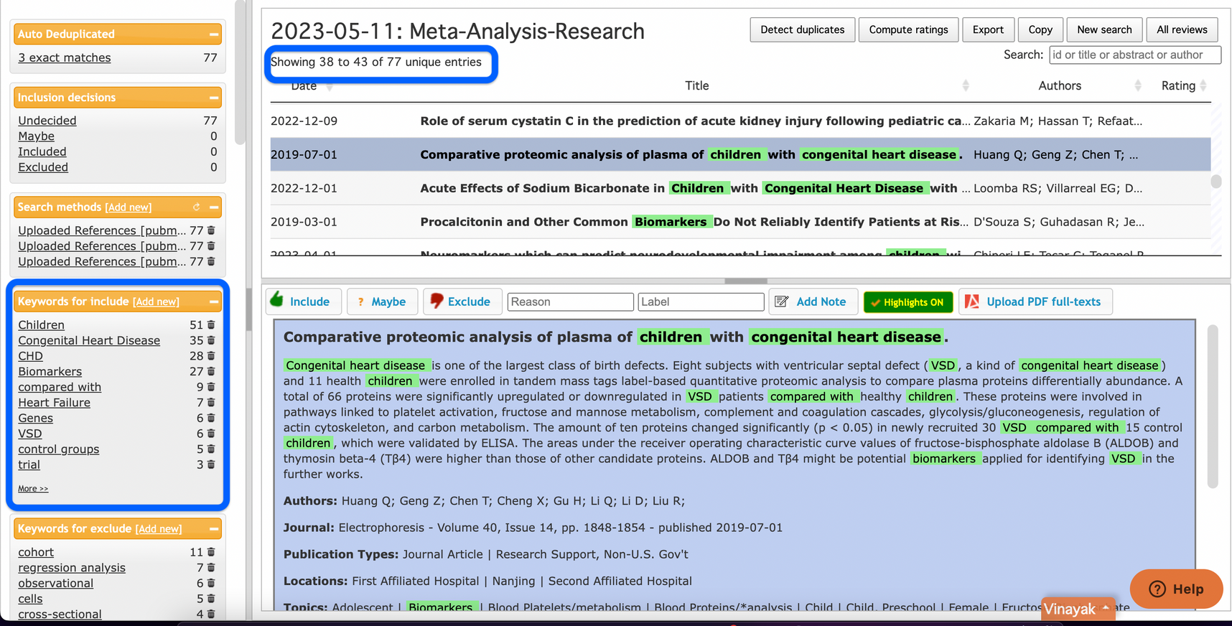
Rayyan - Literature Review
Rayyan was used for screening the articles. The nbib files were uploaded to Rayyan.ai which used AI and NLP to filter out articles relevant to our research topic

Slide 8
2
Handling Bias in Studies
Performed by Arbaaz, Arman and Ieshaan

Slide 9
RoB2 for risk-of-bias
1
Randomization process
2
Deviations from intended interventions
3
Missing outcome data
4
Measurement of the outcome
5
Selection of the reported result

Slide 10
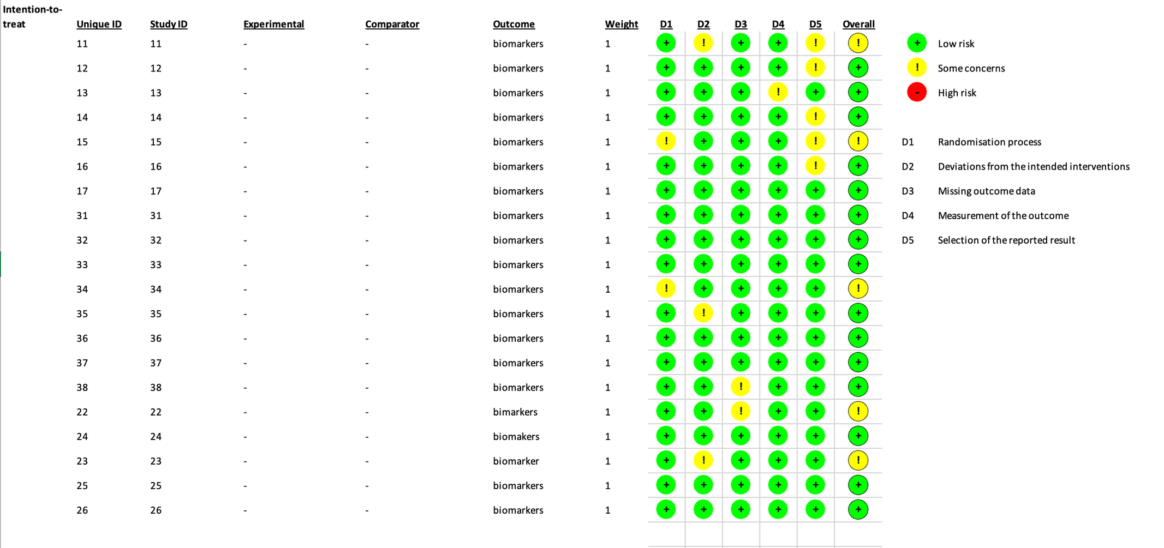
Used RoB2 tool, as mentioned by the cochrane guidelines, for finding risk of bias in all the selected studies

Slide 11
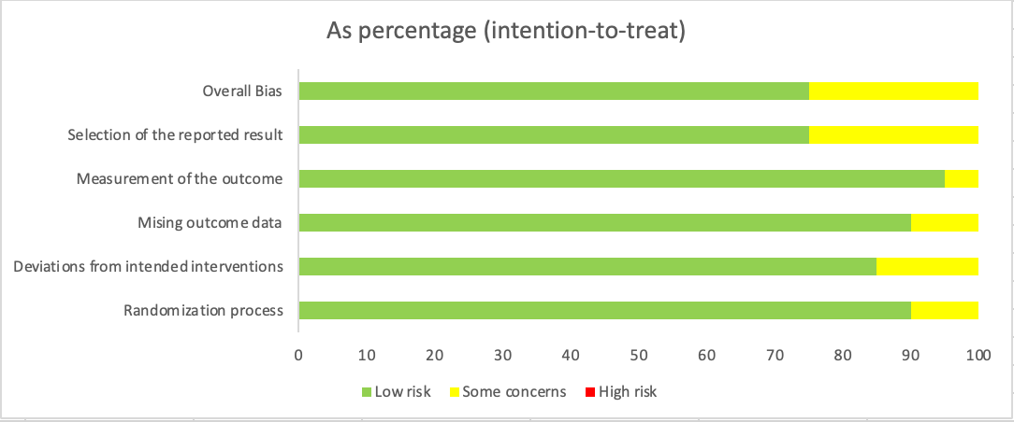
No high risk studies were found. As a consequence, all selected studies were analyzed

Slide 12
3
NER using ScispaCy
Performed by Harshil

Slide 13
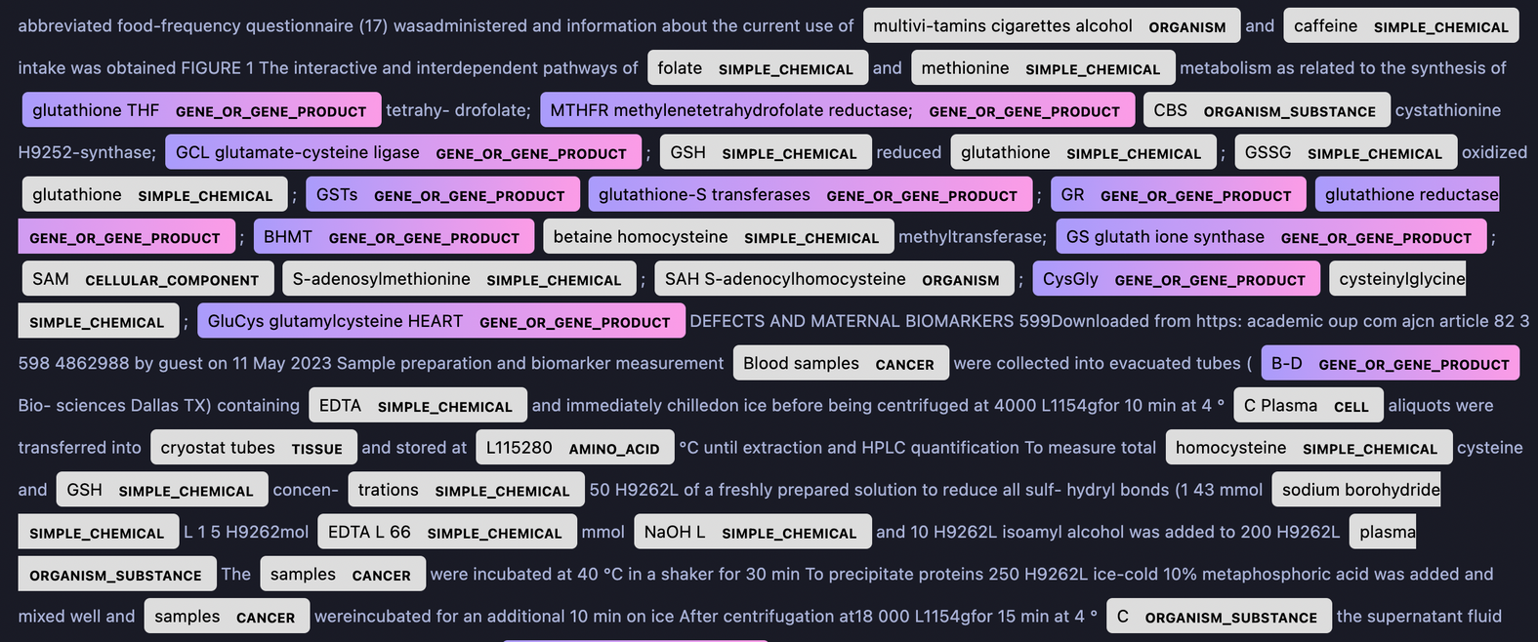
Named Entity Recognition on studies to identify potential biomarkers
NER Model : 'en_ner_bionlp13cg_md' trained on BIONLP13CG corpus

Slide 14
Finding the final biomarkers with biomaRt
POTENTIAL BIOMARKERS
GENES PRESENT IN HUMAN GENOME
Final set of genes

Slide 15
4
Manual Review
Performed by Everyone

Slide 16
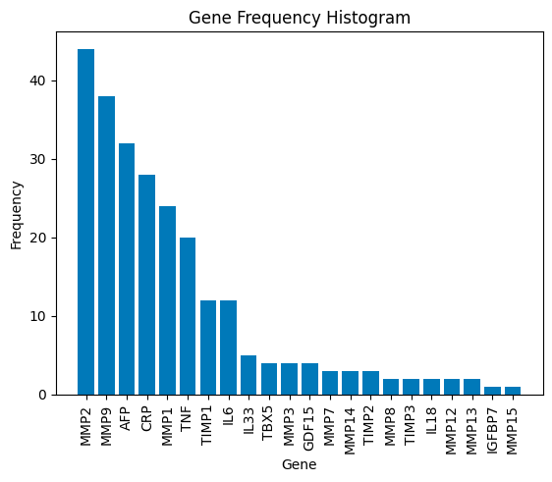
Final Findings

Slide 17
Future Perspective
Moving forward, further research could involve functional studies, validation experiments, and potentially exploring the clinical applications of the identified biomarkers in a real-world setting.

Slide 18
Contributions & Acknowledgements
Arbaaz Choudhari (2021034) - Handling Bias in Studies
Arman Ganjoo (2021018) - Handling Bias in Studies
Harshil Mital (2021050)- NER using ScispaCy
Ieshaan Awasthy (2021054)- Handling Bias in Studies
Ishan Saini (2021465)- Finding and Filtering Articles
Nirmal (2021074) - Finding and Filtering Articles
Vinayak Arora (2021112) - Finding and Filtering Articles
Vinayak Goel (2021113) - Finding and Filtering Articles
Special Thanks to Mr. Alok Anand for his help and guidance

Slide 19
References for Project
Articles
https://jamanetwork.com/journals/jamanetworkopen/fullarticle/2773467
https://medcraveonline.com/JSRT/emerging-biomarkers-of-congenital-heart-diseases-and-disorders.html
https://www.mdpi.com/1422-0067/23/9/4993
https://academic.oup.com/ajcn/article/82/3/598/4862988
https://bmccardiovascdisord.biomedcentral.com/articles/10.1186/s12872-022-02912-2
https://www.tandfonline.com/doi/abs/10.1080/14767058.2021.1914572?journalCode=ijmf20\
https://sci-hub.se/https://www.internationaljournalofcardiology.com/article/S0167-5273(14)00836-5/fulltex
https://bmcpediatr.biomedcentral.com/articles/10.1186/s12887-017-0863-3/tables/3
https://pubmed.ncbi.nlm.nih.gov/26454435/
https://www.ncbi.nlm.nih.gov/pmc/articles/PMC2874565/ https://sci-hub.se/
https://www.sciencedirect.com/science/article/abs/pii/B9781455707607000383
https://www.ncbi.nlm.nih.gov/pmc/articles/PMC8215886/
https://www.cambridge.org/core/journals/cardiology-in-the-young/article/paediatric-heart-failure-understanding-the-pathophysiology-and-the-current-role-of-cardiac-biomarkers-in-clinical-practice/6B88AC84A146D2A817CA2634F0243FFA
https://www.ncbi.nlm.nih.gov/pmc/articles/PMC9344277/
https://www.mdpi.com/1422-0067/23/9/4993
https://sci-hub.se/https://www.futuremedicine.com/doi/full/10.2217/bmm.14.71
https://bmccardiovascdisord.biomedcentral.com/articles/10.1186/s12872-022-02912-2
https://www.tandfonline.com/doi/abs/10.1080/14767058.2021.1914572?journalCode=ijmf20
https://www.sciencedirect.com/science/article/pii/S0002916523275073?via%3Dihub
https://www.ncbi.nlm.nih.gov/pmc/articles/PMC8613676/
https://www.ncbi.nlm.nih.gov/pmc/articles/PMC7902730/
https://www.ncbi.nlm.nih.gov/pmc/articles/PMC9344277/
Documentation and Resources
https://www.cochranelibrary.com/
https://pubmed.ncbi.nlm.nih.gov/
https://asia.ensembl.org/info/data/biomart/biomart_r_package.html
https://www.rayyan.ai/
https://towardsdatascience.com/using-scispacy-for-named-entity-recognition-785389e7918d
https://allenai.github.io/scispacy/

